Slide 1
Lecture 1: Why is money difficult?
Perry Mehrling
Warsaw School of Economics
October 11, 2017

Slide 2
Many Faces of the GFC
Crisis of risk management system
Private: Microprudential, Value At Risk, Basel
Public: Macroeconomic Stabilization, inflation target
Crisis of political economy
Central Bank and Wall Street (US)
Central Bank and State Treasury (Europe)
Central Bank Cooperation (Global)
Crisis of global liquidity system
Funding Liquidity—Lender of Last Resort
Market Liquidity—Dealer of Last Resort

Slide 3
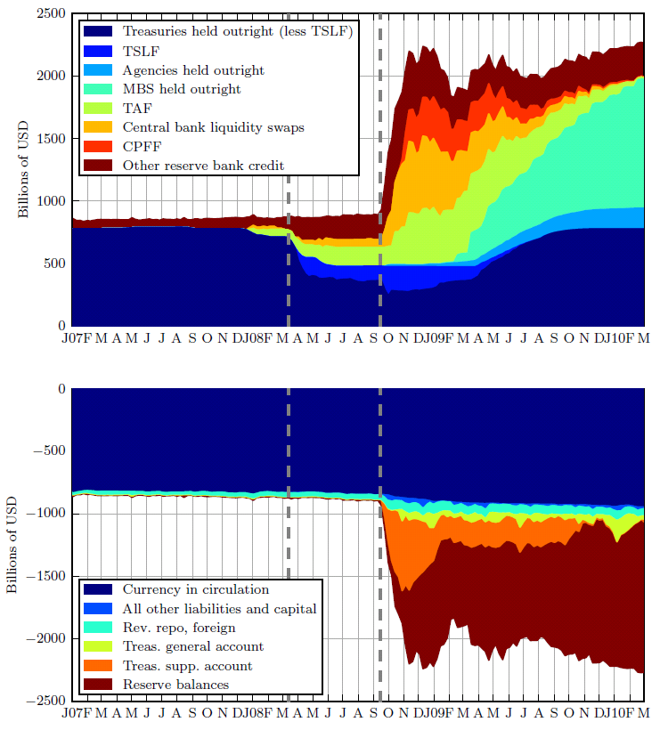
From LOLR to DOLR

Slide 4
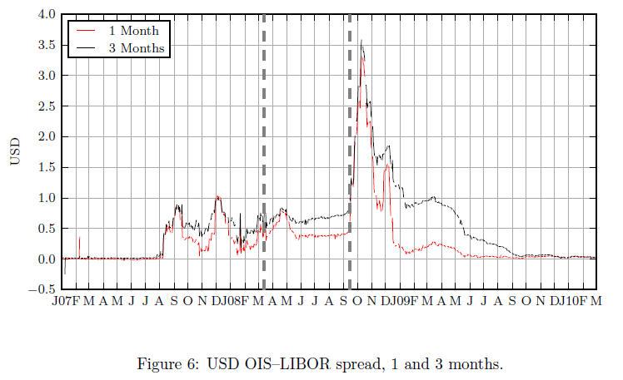
From Domestic to International LOLR

Slide 5
The (Fatal) Abstractions of Modern Economic Thinking
Representative Agent
Intertemporal Equilibrium
Monetary Veil (Neutrality)
Legal Foundations
Market Microstructure
Liquidity

Slide 6
The Money View
Banking as a Payments System
Copeland (1952): A Moneyflow Economy
Minsky (1957): The Survival Constraint
Banking as a Market Making System
Hawtrey (1919): Hierarchy of Money and Credit
Hicks (1989): Centrality of the Dealer Function
Bagehot (1873): Dealer of Last Resort

Slide 7
Why is money difficult?

Slide 8
I. Alchemy
Bank Me
Banking is a swap of IOUs
Assets | Liabilities | Assets | Liabilities
+loan | +deposit | +deposit | +loan

Slide 9
Psychological Barrier
Fetish of the “Real”: What is being “loaned”?
Fraud?
Free lunch resistance: Something from nothing?
“Inside” or credit character of money, versus “outside” personal experience of money

Slide 10
II. Hybridity
Money Supply, Public and Private
Central Bank Bank
Central Bank, Government Bank and Bankers’ Bank
Assets | Liabilities | Assets | Liabilities
 | Currency |  | Deposits
Assets | Liabilities
Treasury Securities Discounts | Treasury account Reserves

Slide 11
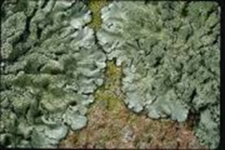
Political Barrier
Left: Chartalism, Knapp, MMT
Money as creation of the state, “authority”
Right: Metallism, Menger, Austrian
Money as creation of the marketplace, “trust”
Symbiosis: as lichen, algae + fungi

Slide 12
III. Hierarchy
Gold
Currency
Deposits
Securities

Slide 13
Ideological Barrier
Economic ideology: men are equal, but liabilities of men unequal
Westphalian ideology: sovereigns are equal, but liabilities of sovereigns unequal
Credit as promise to pay money; money as the highest form of credit

Slide 14
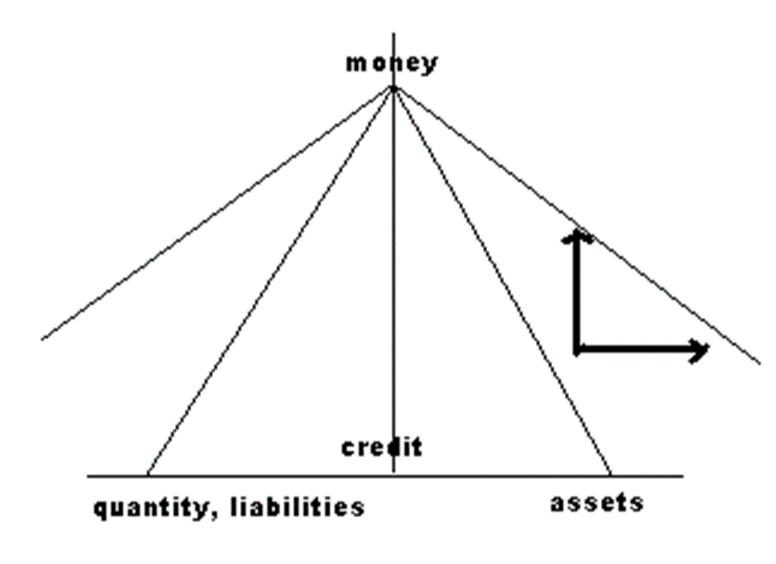
IV. Instability

Slide 15
Equilibrium Barrier
Prices “clear” markets, and time is just an additional dimension of commodity space
Instability comes from outside, exogenous shocks absorbed through price flexibility
Incipient incoherence between cash flows and cash commitments absorbed by balance sheet expansion higher up in the hierarchy

Slide 16
A Moneyflow economy

Slide 17
Settlement as Coherence
“The web of interlocking debt commitments, each one a more or less rash promise about an uncertain future, is like a bridge that we collectively spin out into the unknown future toward shores not yet visible. It is in the daily operation of the money market that the coherence of the credit system, that vast web of promises to pay, is tested and resolved as cash flows meet cash commitments.” (New Lombard Street, p. 3)

Slide 18
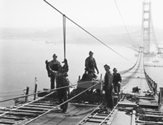
“like a bridge we spin…”

Slide 19
Hierarchy of Dealers, Prices of Money

Slide 20
Financial Globalization and Shadow Banking

Slide 21
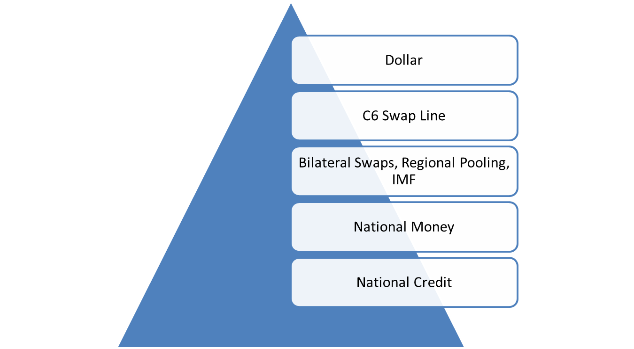
International Hierarchy of Money

Slide 22
“Breaking Free of the Triple Coincidence” (BIS #524)
Pure offshore transactions
Roundtrip transactions
Outflow
Inflow

Slide 23
Hierarchy of Alchemy
Bank Me
Central Bank Bank
Fed ECB
Assets | Liabilities | Assets | Liabilities
+loan | +deposit | +deposit | +loan
Assets | Liabilities | Assets | Liabilities
+discount | +currency | +currency | +discount
Assets | Liabilities | Assets | Liabilities
+euros | +dollars | +dollars | +euros

Slide 24
Payment Versus Funding, I
Me My Bank Your Bank You
Purchase of house facilitated by “alchemy”, seller funding and interbank borrowing, in the first instance
A | L | A | L | A | L | A | L
+deposit -deposit +house | +loan | +loan | +deposit -deposit +Fed Funds | +Fed Funds | +deposit | +deposit -house

Slide 25
Payment Versus Funding, IIa
Insurance My Bank Your Bank Society
Final funding of loan facilitated by money destruction, larger society funding
A | L | A | L | A | L | A | L
+deposit -deposit +loan | +annuity | -loan +deposit -deposit | -Fed Funds | -Fed Funds | -deposit | -deposit +annuity

Slide 26
Payment Versus Funding, IIb
SPV My Bank Your Bank Society
Final funding of the loan facilitated by shadow banking, society funding
A | L | A | L | A | L | A | L
+deposit -deposit +RMBS | +MM funding | +deposit -loan -deposit | -Fed Funds | -Fed Funds | -deposit | -deposit +MM funding

Slide 27
Crisis and Prices

Slide 28
Crisis and Balance Sheets

Slide 29
System Dynamics and Thought Dynamics
Elasticity of Credit vs. Discipline of Money
Banking School vs. Currency School
Bankers’ bank vs. Government Bank
Peace finance vs. War (Development) finance
Bank credit vs. Market Credit
Monetary economics vs. Financial economics
Core vs. Periphery
Global finance vs. National finance

Slide 30
Inflation?
Goods prices, the fourth price of money, a work in progress
Formed by marketmakers in primary commodities: oil, wheat
Spot vs. forward, storage public and private
Tax-based Incomes Policy?
Labor as primary commodity
Reserve army of the unemployed
Job Guarantee as buffer stock?
Economics of the Dealer Function

